Slide 1

DestiNation: AI Based Career Counseling
At our career counseling website, we empower students to discover their true passions and unlock their full potential. Our tailored guidance helps you navigate the path to a fulfilling career, one step at a time.

Slide 2

Our Mission
1
Unlock Potential
2
Personalized Guidance
We believe every student has unique talents and strengths. Our mission is to help you uncover and harness your true potential.
Our expert counselors provide personalized support to guide you through the complexities of career planning.
3
Inspire Confidence
We aim to instill self-confidence and equip you with the tools to make informed decisions about your future.

Slide 3
Key Features
Comprehensive Assessments
Tailored Recommendations
24 x 7 Chat-Bot Support
Personalized guidance to explore career options and create a actionable plan in order to create a proper mastery over the preferred field of choice.
Access to a vast expertise of DestiNation at the fingertips of your hands for you career related queries, anytime & anywhere.
Our in-depth personality and interest assessments help you identify your strengths, interests, and values to find the perfect fit.

Slide 4
Target Audience
High School Students
College Students
Discover your true passions and explore a wide range of career pathways to set you up for success.
Navigate the complexities of choosing a major, landing internships, and transitioning into the workforce.
Recent Graduates
Career Changers
Receive tailored support to identify your strengths, find fulfilling opportunities, and kick-start your career.
Unlock new possibilities and reinvent yourself with our guidance on career exploration and transition.

Slide 5

Revenue Model
1
Subscription Plans
Offer tiered subscription plans for access to our comprehensive career counseling services.
2
Personalized Coaching
Provide one-on-one coaching sessions with our expert career counselors for a premium fee.
3
Partnerships
Collaborate with educational institutions and employers to offer specialized programs and services.

Slide 6
Competitive Landscape
Specialized Expertise
Holistic Approach
Personalized Experience
Differentiate by employing a team of highly qualified career counselors with deep industry experience.
Provide a comprehensive suite of services that address all aspects of career development.
Offer a customized journey for each student, tailored to their unique needs and aspirations.

Slide 7




Marketing Strategy
Social Media
Email Marketing
Optimized Website
Strategic Partnerships
Leverage social platforms to engage with students, share valuable content, and build a strong online presence.
Nurture leads and keep students informed with personalized email campaigns and newsletters.
Create a user-friendly, informative website that showcases our services and helps students self-navigate.
Collaborate with educational institutions, career fairs, and student organizations to reach our target audience.

Slide 8
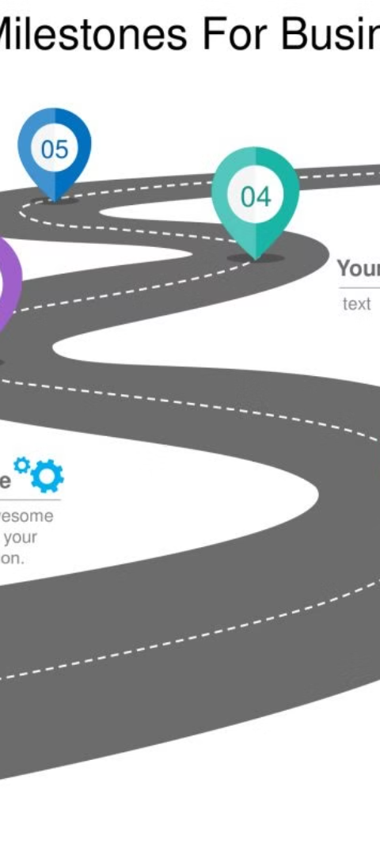



Future Plans
Expand Services
Continuously enhance our offerings to meet the evolving needs of students and stay ahead of industry trends.
Leverage Technology
Invest in cutting-edge technology and AI-powered tools to deliver a seamless and efficient user experience.
Global Reach
Explore international expansion to provide our career counseling expertise to students around the world.

